Slide 2


Slide 3


Slide 4
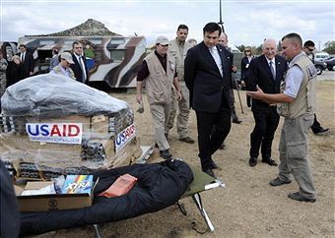

Slide 5
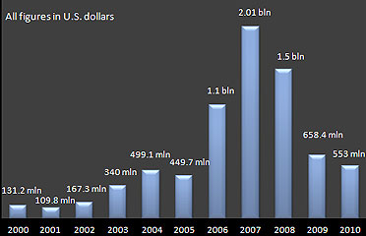
Foreign Direct Investment for Georgia, 2000-2010 (millions USD)

Slide 6
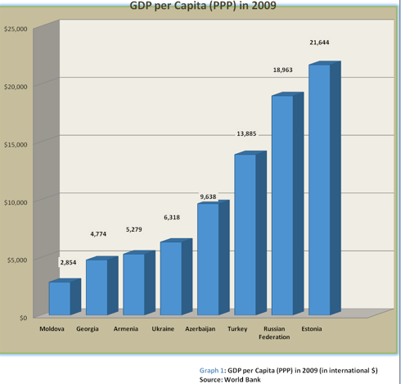

Slide 7
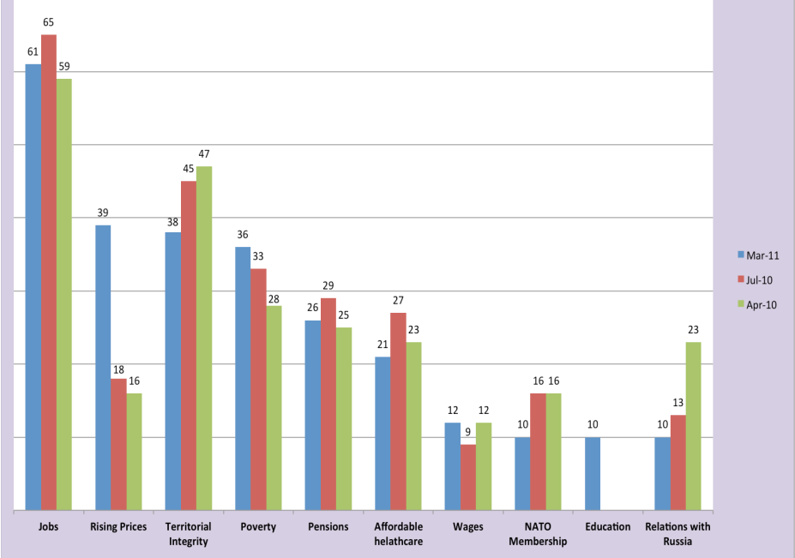
Most Important Issues for Georgians, 2010-2011

Slide 8
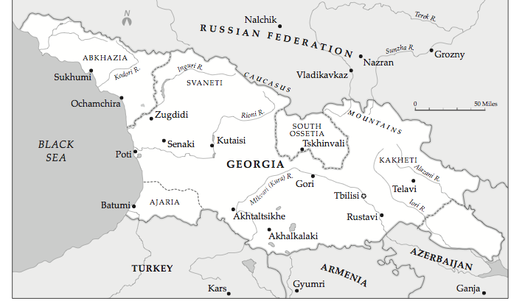

Slide 9
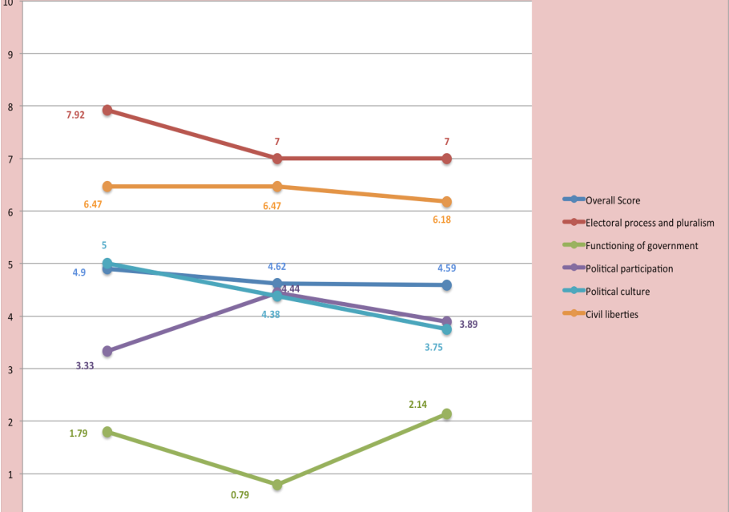
Georgia Democracy Index 2006-2010s

Slide 10
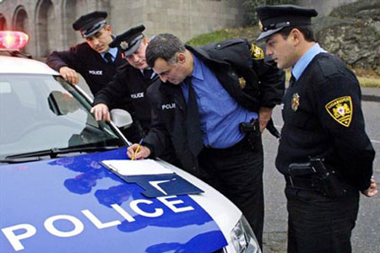

Slide 11
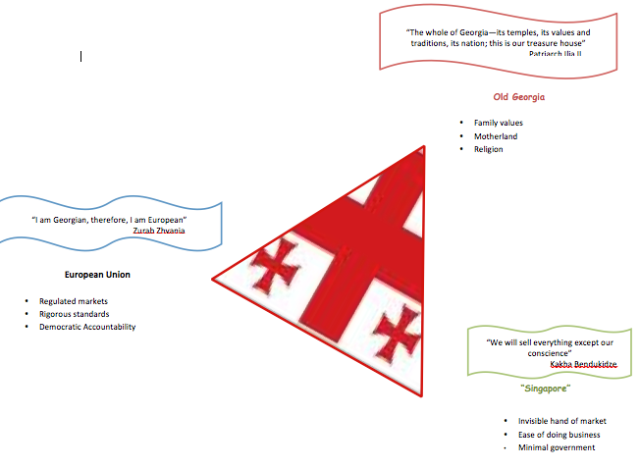

Slide 12
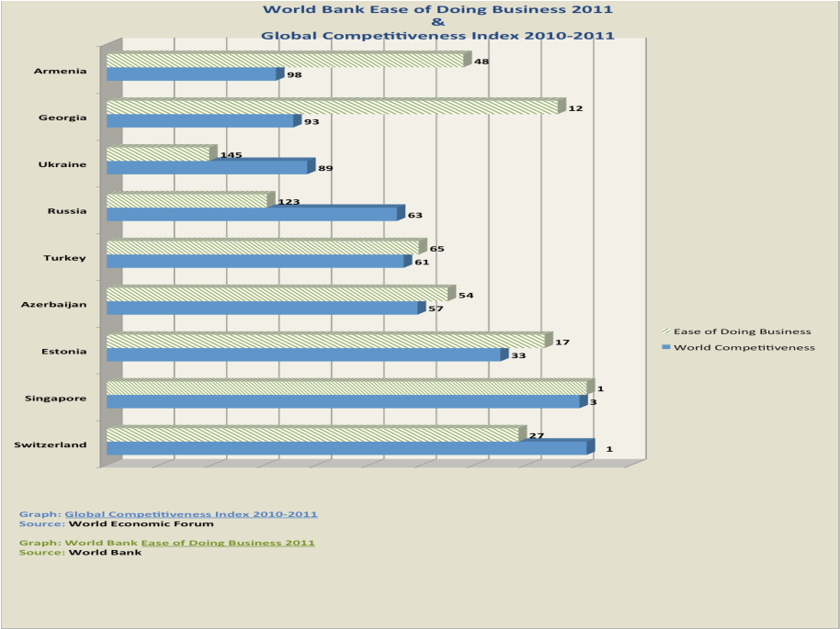

Slide 13


